Slide 1
TRAINING OBJECTIVES
Why we need Knoesis?
What is well stimulation?
What is a reservoir?
What is testing a well?
What is well production?
What are phases of oil recovery?
What is Enhanced Oil Recovery?
Notes:
Well test or drill stem testing (DST)
This process is conducted generally with exploration wells and is a key to whether a well has found a commercial hydrocarbon reservoir
Well test or drill stem testing: (Quá trình thử vỉa)
Quá trình này thường áp dụng cho những giếng khoan thăm dò, khi khoan xong giếng này, để kiểm tra xem vỉa ở khu vực này có khả năng sinh dầu thương mại hay không. Từ đó mới đưa ra quyết định là có đưa mỏ vào giai đoạn khai thác và phát triển hay không.

Slide 2
WELL STIMULATION
WHAT IS WELL STIMULATION
INTRODUCE ABOUT RESERVOIR
WHY DO WE NEED WELL STIMULATION?
STIMULATE A WELL WHILE TESTING
STIMULATE A WELL WHILE PRODUCTION
Notes:
Well stimulation: this is process which people applied sophisticated technologies to bring as much oil as they can
Well stimulation: (Kích thích vỉa). Đây là một thuật ngữ dùng chung cho quá trình áp dụng những công nghệ hiện đại để tăng cường thu hồi dầu

Slide 3
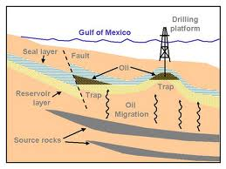
What is a reservoir?

Slide 4
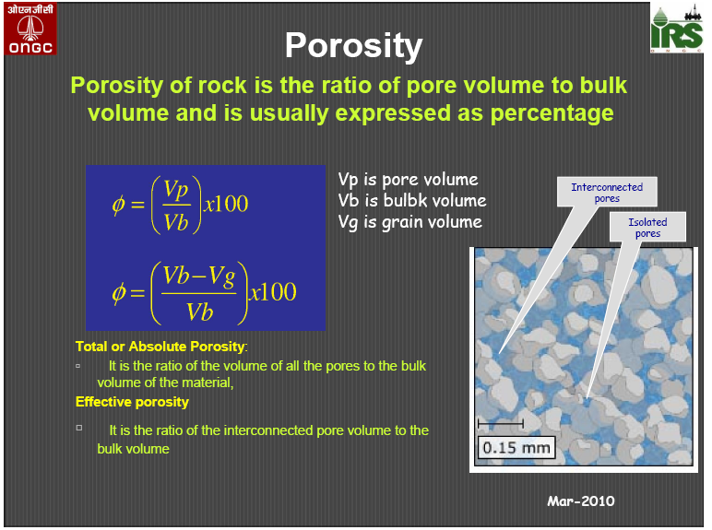
What is porosity?

Slide 5
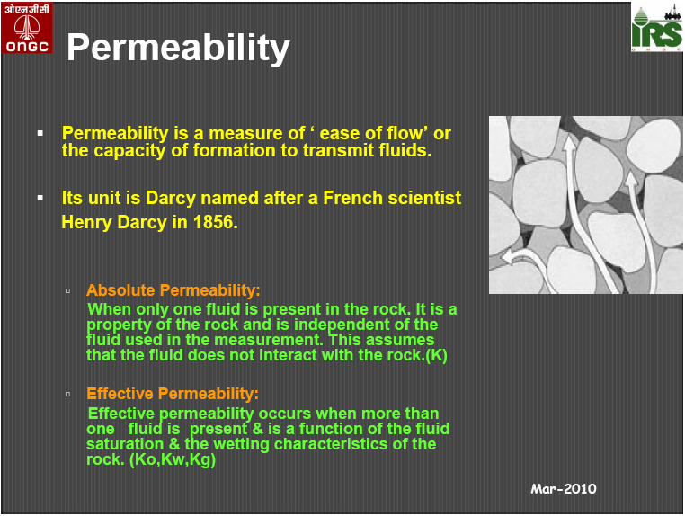
What is permeability?

Slide 6
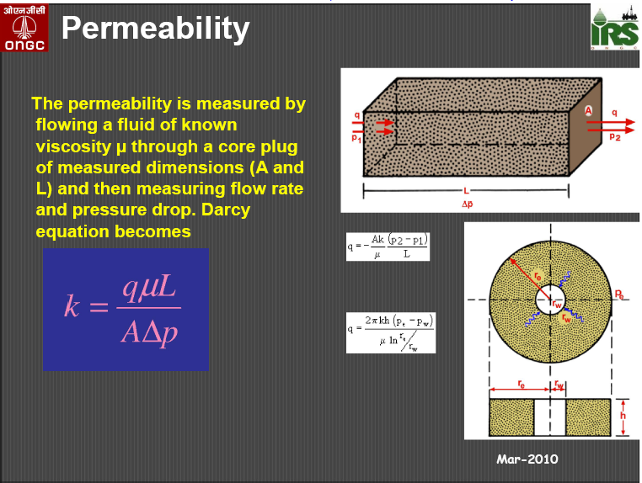
What is permeability?

Slide 7
Reservoir and permeability
The permeability of average reservoir rocks generally range between 5 and 1000 millidarcys
A rough field appraisal of reservoir permeability is:
  Fair 1-10 md
  Good 10-100 md
  Very good 100-1,000 md

Slide 8
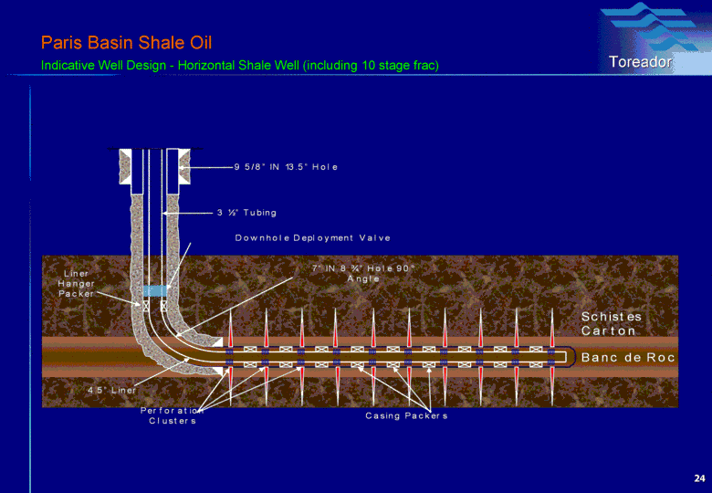
WHY DO WE NEED TO STIMULATE
Notes:
Perforation: is a process by using gun or mine to punch holes in the production tubing in order to make the well and reservoir connect with each others
Perforation: (Quá trình bắn mở vỉa). Sau khoan xong một giếng thăm dò, bước tiếp theo là người ta phải kiểm tra xem vỉa ở giếng đó có dầu thương mại hay không. Để làm được điều này, người ta phải đưa xuống giếng những đoạn ống hình trụ tròn và đường kính khoảng 3.5 inch xuống tới chỗ vỉa mà chúng ta muốn kiểm tra ( ống này gọi là production tubing hay ống khai thác). Trong các đoạn ống này, mìn và ngòi nổ được gắn sẵn trước khi đưa xuống giếng, khi đưa xuống tới target rồi, người ta kích hoạt các ngòi nổ để khoan các lỗ lên trên các ống tubing khai thác. Kết quả là vỉa và giếng được liên thông với nhau và dầu/khí từ vỉa có thể chảy vào giếng.

Slide 9
Improve permeability of a reservoir
Improve productivity of a reservoir
Maintained pressure of reservoir
Why we need to stimulate a well

Slide 10
STIMULATE WHILE TESTING
Methods
Fracturing
Acidizing

Slide 11
FRACTURING
Fracturing is done after the well has been completed, that is, the well has casing, tubing, and has been perforated.
The technique uses high - pressure lines to the well tubing. A special fluid mixture, often composed of mainly water and sand, is pumped down the tubing to the bottom of the well.
Pumping continues till the pressure becomes so high it overcomes the strength of the reservoir rock and cracks it open. The sand in the fracturing fluid holds the fracture apart so that reservoir fluids can flow into the fracture and to the well.

Slide 12
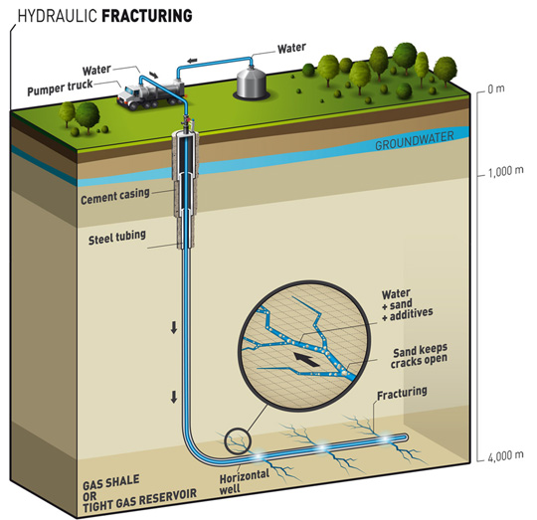
FRACTURING

Slide 13
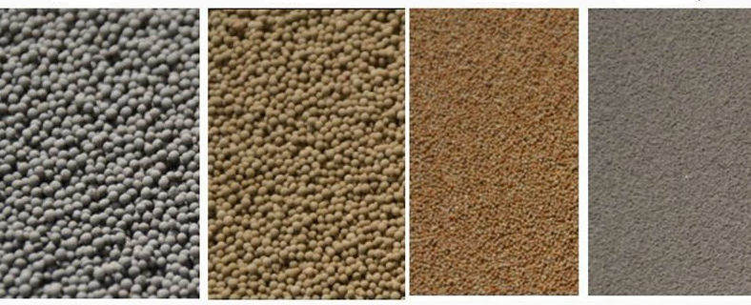
FRACTURING MATERIAL

Slide 14
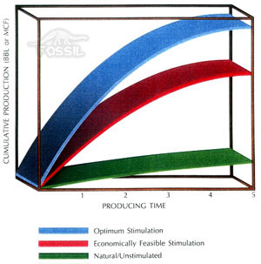
PRODUCTION VERSUS TIME

Slide 15
ACIDIZING
Methods
Fracture acidizing
Matrix acidizing

Slide 16
FRACTURING ACIDIZING
Involve pumping acid into the reservoir at a pressure high enough to cause it to fracture.
Fracture acidizing is similar to fracturing; however, acid instead of water is used as a fracturing fluid.
The acid etches the face (each side) of the fracture to create flow channels for reservoir fluids.
Fracture acidizing is utilized mainly in limestone formations.

Slide 17
MATRIX ACIDIZING
In this method acid is injected down the tubing and into the permeable channels of the reservoir.
The injection pressure is kept low enough to prevent fracturing the formation.
Certain acids can remove substances that block reservoir permeability, especially mud solids

Slide 18
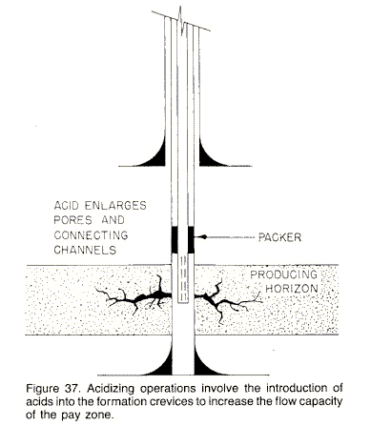
Matrix acidizing

Slide 19
STIMULATE WHILE PRODUCTION
Primary recovery phase
  water drive
  gas drive
Supplementary recovery phase
  Secondary recovery
    Water flooding
    Gas injection
  EOR (Enhanced oil recovery)
    Miscible displacement
    Chemical injection
    Thermal recovery

Slide 20
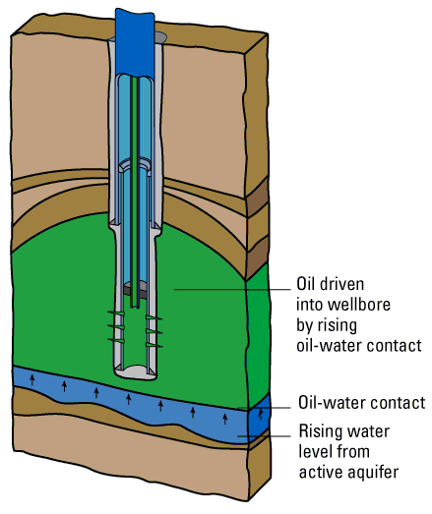
Primary Recovery Phase/ Water Drive
Notes:
A reservoir-drive mechanism whereby the oil is driven through the reservoir by an active aquifer. As the reservoir depletes, the water moving in from the aquifer below displaces the oil until the aquifer energy is expended or the well eventually produces too much water to be viable.

Slide 21
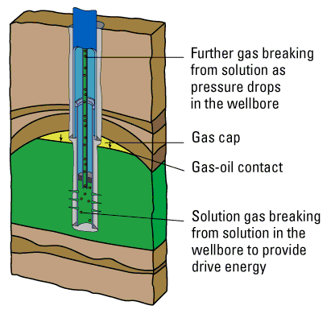
Primary Recovery Phase/ Gas Drive
Notes:
A primary recovery mechanism for oil wells containing dissolved and free gas, whereby the energy of the expanding gas is used to drive the oil from thereservoir formation into the wellbore.

Slide 22
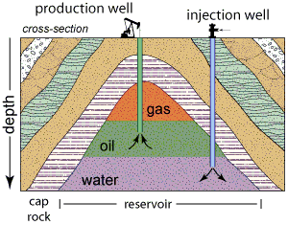
  Secondary recovery/Water Flooding

Slide 23
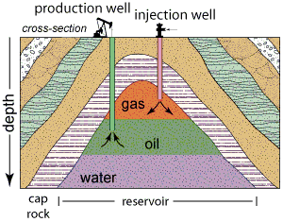
Secondary recovery/Gas Injection
Notes:
Gas is commonly separated from the petroleum and it may be re-injected into the reservoir.
This maintains and in some instances increases the gas cap leading to an enhanced "natural drive“

Slide 24
What is Enhanced oil recovery?
Use sophisticated techniques that alter the original properties of oil.
Can be initiated at any time during the productive life of an oil reservoir.
Its purpose is not only to restore formation pressure, but also to improve oil displacement or fluid flow in the reservoir.

Slide 25
Miscible Displacement
Uses gases such as natural gas, nitrogen, or carbon dioxide that expand in a reservoir to push additional oil to a production wellbore,
other gases that dissolve in the oil to lower its viscosity and improves its flow rate.

Slide 26
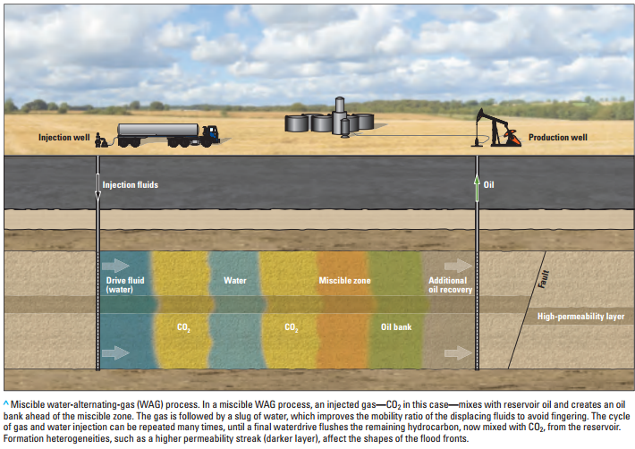
Miscible Displacement

Slide 27
Thermal Recovery
Introduce heat such as the injection of steam to lower the viscosity, or thin, the heavy viscous oil, and improve its ability to flow through the reservoir.
Is used to produce viscous, thick oils with API gravities less than 20. These oils cannot flow unless they are heated and their viscosity is reduced enough to allow flow toward producing wells.
Notes:
Viscosity: Indicates resistance to flow. For example, high viscosity means very difficult to flow like honey (high viscosity) in comparison with water (low viscosity)
Viscosity: (Độ nhớt), thể hiện tính linh động của chất lỏng. Ví dụ mật ong hay dầu thô có độ nhớt cao hơn nước nên tính linh động của nó kém hơn>> khó chảy lấy lên bề mặt hơn.
Người ta quan tâm đến viscosity của chất lưu vì trong vỉa lúc nào cũng có sự tồn tại của dầu/khí và nước. Hiểu được tính chất viscosity của các chất lưu trên để nhằm mục đích đưa ra những phương pháp khai thác dầu tối ưu nhất để lấy được nhiều dầu hơn.
API (American petroleum institute): is a kind of unit measurement for the density of oil. It is measured in degree API.
Note: high degree API means less density oil

Slide 28
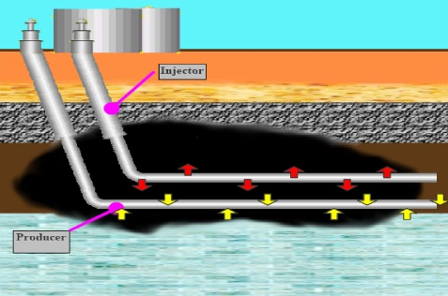
Thermal Recovery

Slide 29
Chemical Injection
Chemical injection
Use of long-chained molecules called polymers
Help to break down the surface tension between the oil and water
To allow oil and gas to separate
Notes:
https://www.slb.com/services/technical_challenges/enhanced_oil_recovery.aspx
Surfactant Polymer flooding these are surface active agents that help to break down the surface tension between the oil and water. This allows for the oil and water to separate. The effect of the surfactant depends on the concentration. In low concentrations the rate is gradual but in higher concentrations the rate is increased until such time that the surfactant is diluted by the formation fluids. It also improves the mobility of the fluids and reverses the rock wettablity.

Slide 30
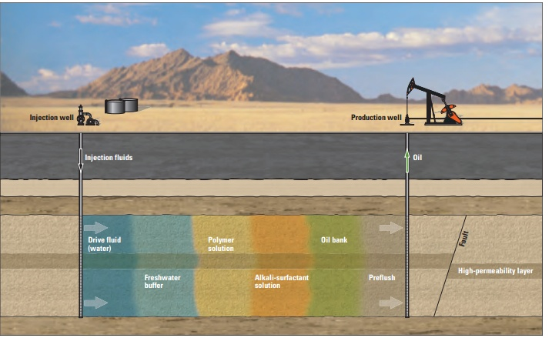
Chemical Injection
Notes:
http://www.oilfieldwiki.com/wiki/Enhanced_oil_recovery

Slide 31
Summary
Three important rock types
  Igneous rock
  Sedimentary rock (O&G objective)
  Metamorphic rock
Five important factors to create a petroleum reservoir
  Source rock: rich organic materials rocks>>> to create oil and gas
  Temperature
  Pressure
  Reservoir: good porosity and permeability rock >>> to store oil and gas
  Seal /cap rock: poor permeability rock>>> to seal oil and gas in reservoir
Oil and gas life cycle
Knoesis software functionality

Slide 32
More details please refer here
www. glossary.oilfield.slb.com
http://www.oilfieldwiki.com/wiki/Enhanced_oil_recovery
\\data-server\LogiGearVN\Halliburton\00_Halliburton\03_Documentations\Petroleum Engineering Training Course\From Domain Team\Oil gas

Slide 33
Summary about Knoesis
Used in Well testing and well production period
Used to design/simulate/monitor the process pumping fluids/solvents/solids down to the well

Slide 34
Mapping/Prospect Generation
Discovery
Reservoir Delineation
Primary Production/Facilities
Enhanced Recovery
Abandon
Acquire/
Divest
Oil Field
Life Cycle
Notes:
We have a process the describe the Oilfield Life cycle and it exists so that we within Landmark are communicating with ourselves and with our customer
Landmark History

